Slide 1
Psychophysical Adaptive Algorithms
Duncan Tulimieri
April 2, 2021

Slide 2
If it’s not broke, don’t fix it … just make it better
Method of adjustment
Takes observer long time
Method of constant
Experiment takes a long time
Adaptive methods
Take less time so people don’t fall asleep

Slide 3
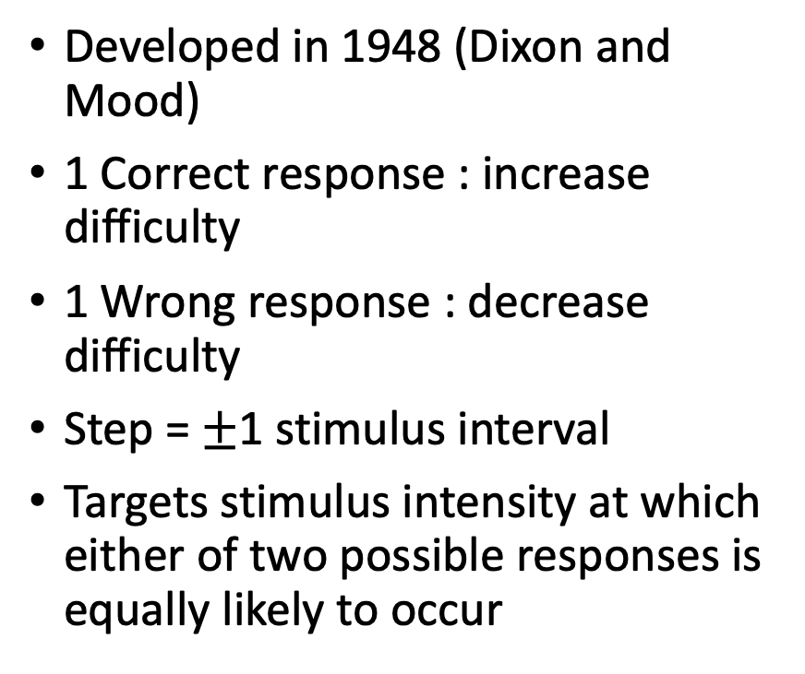
Up/Down
1 up & 1 down
Developed in 1948 (Dixon and Mood)
1 Correct response : increase difficulty
1 Wrong response : decrease difficulty
Step = $±$1 stimulus interval
Targets stimulus intensity at which either of two possible responses is equally likely to occur

Slide 4
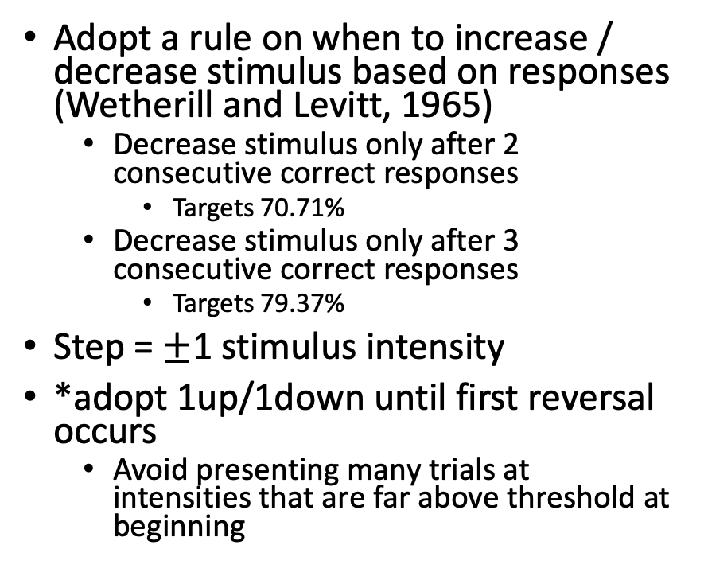
Transformed Up/Down
1 up & 2 down
Adopt a rule on when to increase / decrease stimulus based on responses (Wetherill and Levitt, 1965)
Decrease stimulus only after 2 consecutive correct responses
Targets 70.71%
Decrease stimulus only after 3 consecutive correct responses
Targets 79.37%
Step = $±$1 stimulus intensity
*adopt 1up/1down until first reversal occurs
Avoid presenting many trials at intensities that are far above threshold at beginning

Slide 5

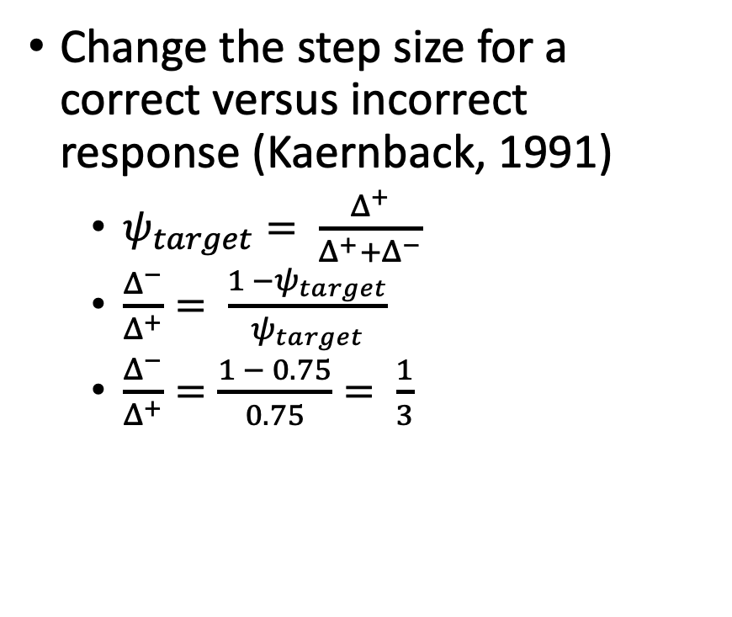
Weighted Up/Down
1 Up & 1 Down, $Δ^{−} 0.3, Δ^{+} 0.9$
Change the step size for a correct versus incorrect response (Kaernback, 1991)
$ψ_{target}= \frac{Δ^{+}}{Δ^{+}+Δ^{−}}$
$\frac{Δ^{−}}{Δ^{+}}= \frac{1 −ψ_{target}}{ψ_{target}}$
$\frac{Δ^{−}}{Δ^{+}}=\frac{1 − 0.75}{0.75}= \frac{1}{3}$

Slide 6

Transformed and Weighted Up/Down
Combine previous 2 methods (Garcìa-Pérez, 1998)
Use a couple of previous trials and change step size
1 Up & 2 Down, $Δ^{−} 0.1, Δ^{+} 0.15$

Slide 7
Up/Down Methods
Termination & Threshold estimate
Termination
Specific # of reversals in algorithm (Garcìa-Pérez, 1998)
Total # of trials
Threshold
Average of last few trials
Hybrid approach - Fit PF to all data with MLE (Hall, 1981)
Assume 3 parameters
Individual or group level

Slide 8
Up/Down Methods
Practical Tips
Certain step sizes converge better than others (Garcìa-Pérez, 1998)
Strong trial-by-trial dependencies exist
Observers can figure these out
Interleave random trials
Drawbacks
Greedy algorithm
Only take 1 (sometimes more) data into account
Only estimate 1 parameter (PSE)
Assume
Observer beta, gamma, lambda, optimal step up, optimal step down, step size

Slide 9
Up/Down Methods
What happens when the experimenter assumes wrong parameters?

Slide 10
Running Fit Methods
Fit data as it is recorded and use to inform stimulus for the next trial

Slide 11
The Best PEST (Pentland, 1980)
Use MLE to estimate PSE
Estimate is next trial stimulus level
Assume 3 other parameters
Initiation of algorithm
First stimulus @ theorized PSE
Second stimulus bound by observer

Slide 12
The Quest (Watson and Pelli, 1983)
Bayesian version of best PEST
Estimate PSE based on posterior distribution
Estimate is next trials stimulus
Initiation of algorithm
First stimulus @ theorized PSE
Second stimulus bound by observer (but much closer to theorized PSE)

Slide 13
The Quest (Watson and Pelli, 1983)

Slide 14
Running Fits
Termination and Threshold
Terminate – specific # of trials
Threshold – last estimate
Ignore prior or keep
Hybrid approach
Use to estimate PSE, but estimate parameters using all data
Drawbacks
Only estimate 1 parameter (PSE) – assume 3 other parameters
Assumption for slope can change step sizes
Tend to be robust even if assumptions are wrong *
Computationally heavy (depending on choice of algorithm)

Slide 15
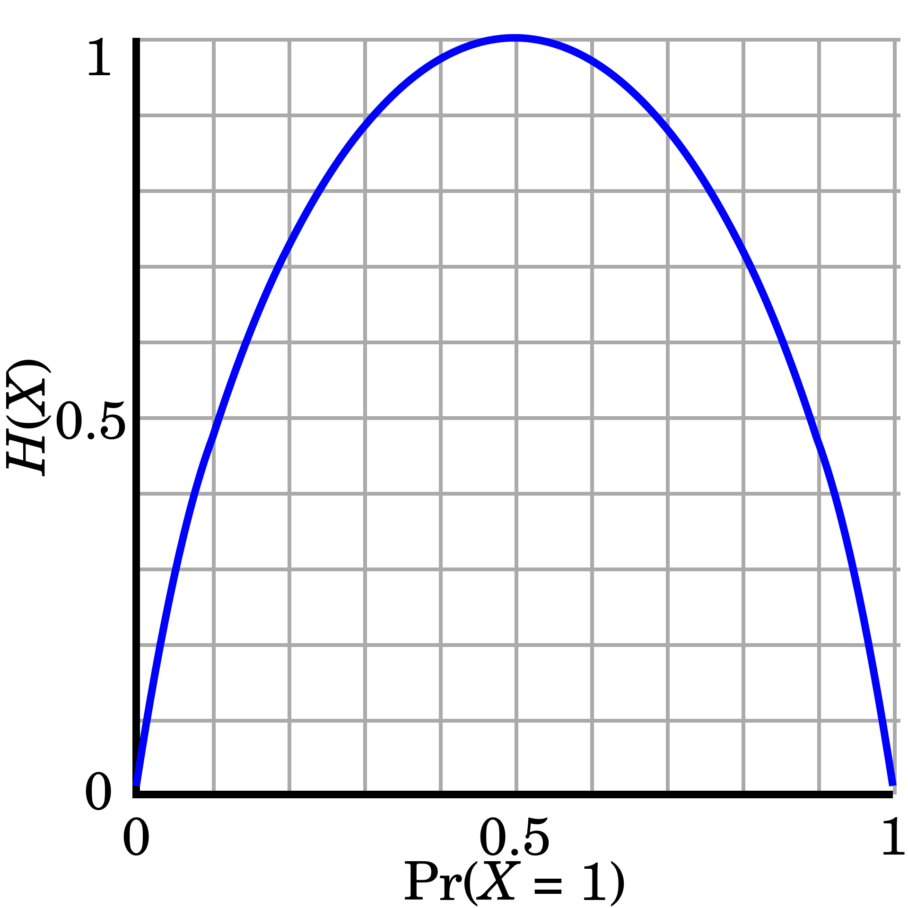
Psi
Selects stimulus amplitudes so as to result in efficient estimation of threshold and slope (Kontsevich and Tyler, 1999)
After each trail, update posterior [2D]
Select stimulus intensity that minimizes expected entropy in posterior distribution after that trial
Entropy – measure of uncertainty
Low entropy = high degree of precision

Slide 16
Psi cont.
Consider range of stimuli
For each stimuli in range, calculate entropy that would result from both a correct and incorrect response
For each stimuli in range, calculate probability of obtaining correct and incorrect response
Combine and choose next stimuli as minimum of posterior distribution
After each trial, find best fitting PF to continuously updated posterior distribution
Use this to calculate probability of of obtaining correct response

Slide 17
Psi-marginal
Use Psi method, but calculate across all dimensions
Marginalize undesired dimension (typically lambda and gamma)
Choose stimulus that will result in most information gain (highest entropy)

